Slide 1
Chapter 14 JavaFX Basics

Slide 2
Motivations
JavaFX is a new framework for developing Java GUI programs. The JavaFX API is an excellent example of how the object-oriented principle is applied. This chapter serves two purposes. First, it presents the basics of JavaFX programming. Second, it uses JavaFX to demonstrate OOP. Specifically, this chapter introduces the framework of JavaFX and discusses JavaFX GUI components and their relationships.

Slide 3
JavaFX vs Swing and AWT
Swing and AWT are replaced by the JavaFX platform for developing rich Internet applications.
With the release of Java 8, Swing is replaced by a completely new GUI platform known as JavaFX.

Slide 4
AWT
When Java was introduced, the GUI classes were bundled in a library known as the Abstract Windows Toolkit (AWT).
AWT is fine for developing simple graphical user interfaces, but not for developing comprehensive GUI projects. In addition, AWT is prone to platform-specific bugs.

Slide 5
Swing
The AWT user-interface components were replaced by a more robust, versatile, and flexible library known as Swing components.
Swing components are painted directly on canvases using Java code.
Swing components depend less on the target platform and use less of the native GUI resource.

Slide 6
Basic Structure of JavaFX
Application
Override the start(Stage) method
Stage, Scene, and Nodes
Code Examples: MyJavaFx.java, MultipleStateDemo.java

Slide 7
Application
All JavaFX programs must extend Application (javafx.application.Application) class.
The start method must be overridden by the extending class and serves as the starting point for the GUI thread
So like main() – each JavaFX program has one and only one class extending Application and one start() method.

Slide 8
Basic Program
import javafx.application.Application;
import javafx.scene.Scene;
import javafx.scene.control.Button;
import javafx.stage.Stage;
public class MyJavaFX extends Application
{
// Override the start method in the Application class
public void start(Stage primaryStage)
{
// Create a button and place it in the scene
Button btOK = new Button("OK");
Scene scene = new Scene(btOK, 200, 250);
primaryStage.setTitle("MyJavaFX"); // Set the stage title
primaryStage.setScene(scene); // Place the scene in the stage
primaryStage.show(); // Display the stage
}
/**
* The main method is only needed for the IDE with limited JavaFX support.
* Not needed for running from the command line.
*/
public static void main(String[] args)
{
launch(args);
}
}

Slide 9
launch method
Some IDE’s don’t require a main() for FX programs- Eclipse does. Your main should call launch() as in example above.
The launch method called in main is a static method defined in the parent Application class.
The start method is non-static method of the parent Application class and where we add content to our GUI.

Slide 10
Components
The first lines of start() create components which we are adding to the GUI- FX calls these Nodes
Button objects create a button object
Scene object provides a panel on which other components can be placed.
It is then placed into the Stage object passed in as a parameter.
A Stage object is basically a window.

Slide 11
Scene’s and Stages
Scene objects are placed on Stages
You can also have multiple Stages in your Application- see MultipleStageDemo.java

Slide 12
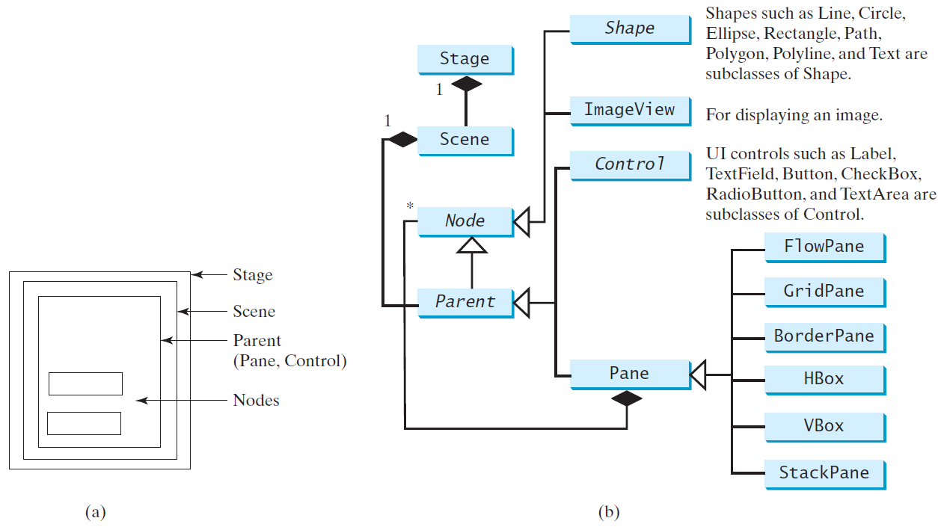
Panes, UI Controls, and Shapes

Slide 13
Example file
ButtoninPane.java

Slide 14
Display a Shape
This example displays a circle in the center of the pane.

Slide 15
Example File
ShowCircle.java

Slide 16
Java FX components and layouts
The next section looks at library classes that allow us to add and customize components in our Stage and Scene

Slide 17
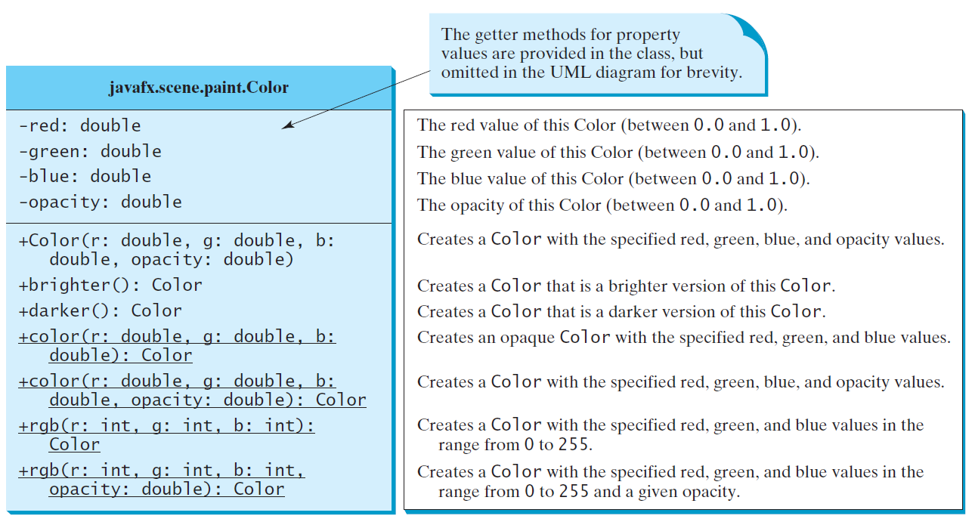
The Color Class

Slide 18
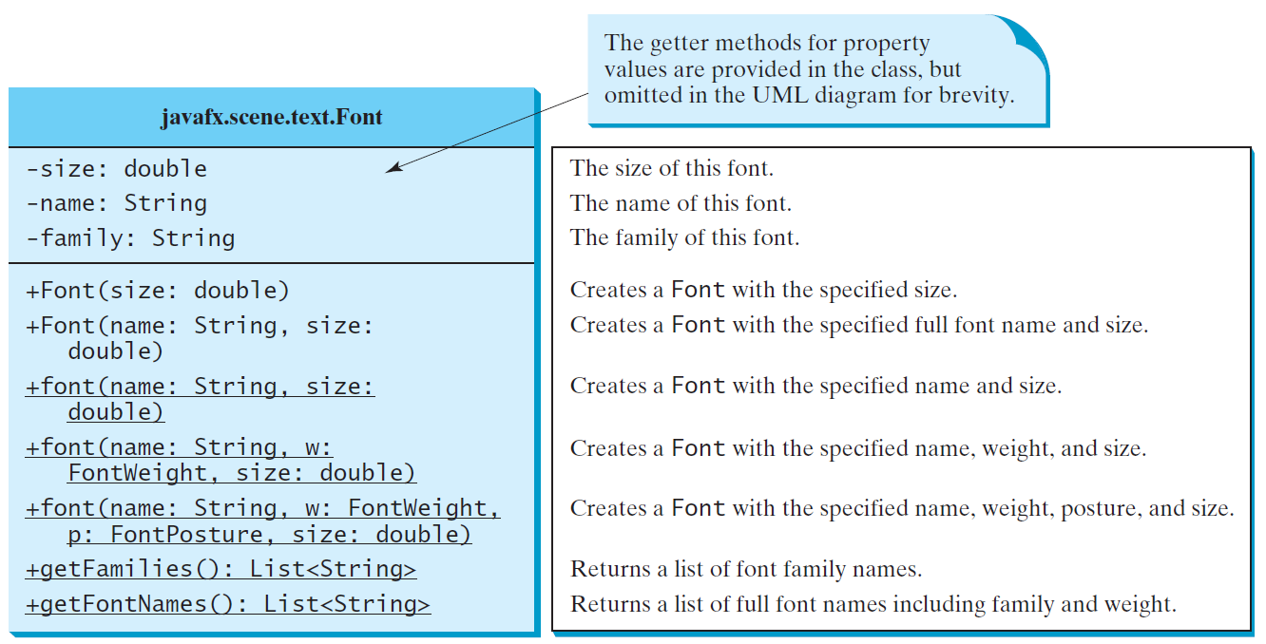
The Font Class
FontDemo

Slide 19
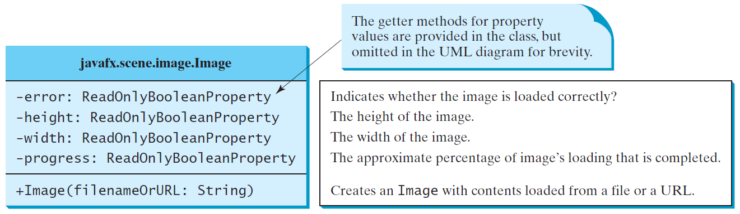
The Image Class

Slide 20
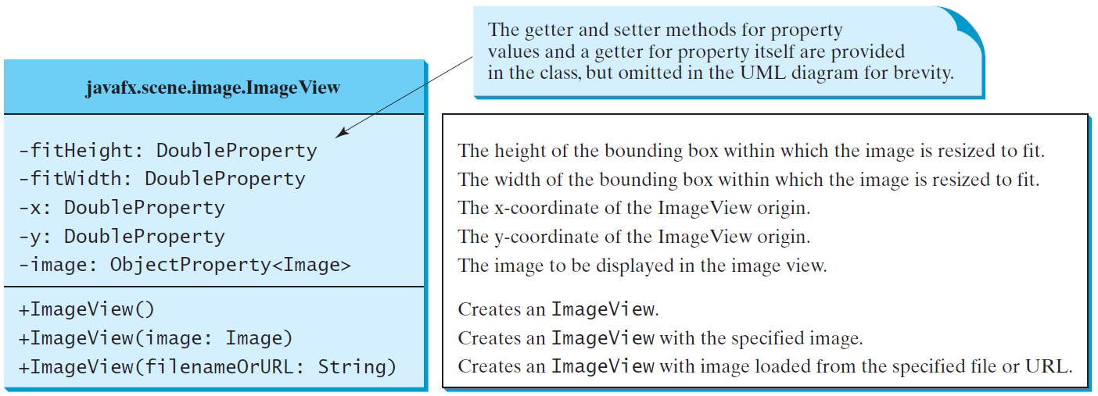
The ImageView Class
ShowImage

Slide 21
ShowImage.java
In order to properly run this demo, you must first download the us.gif file from D2L- it is not in the zip file.
Create a new folder in project/src directory titled image.
Place us.gif in that folder.
Images default location is the src directory- this example looks in image/us.gif.

Slide 22
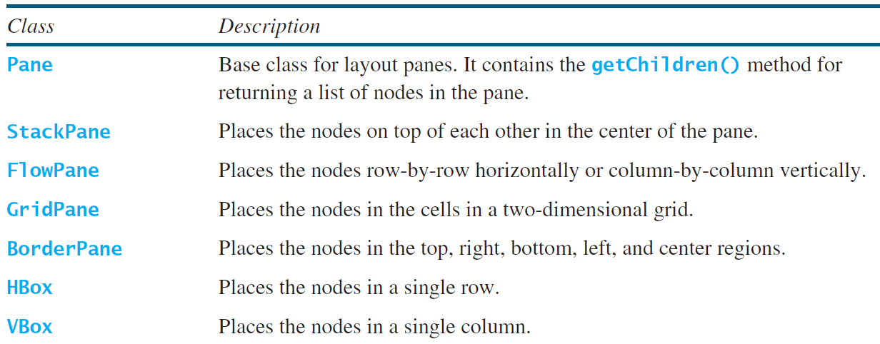
Layout Panes
JavaFX provides many types of panes for organizing nodes in a container.

Slide 23
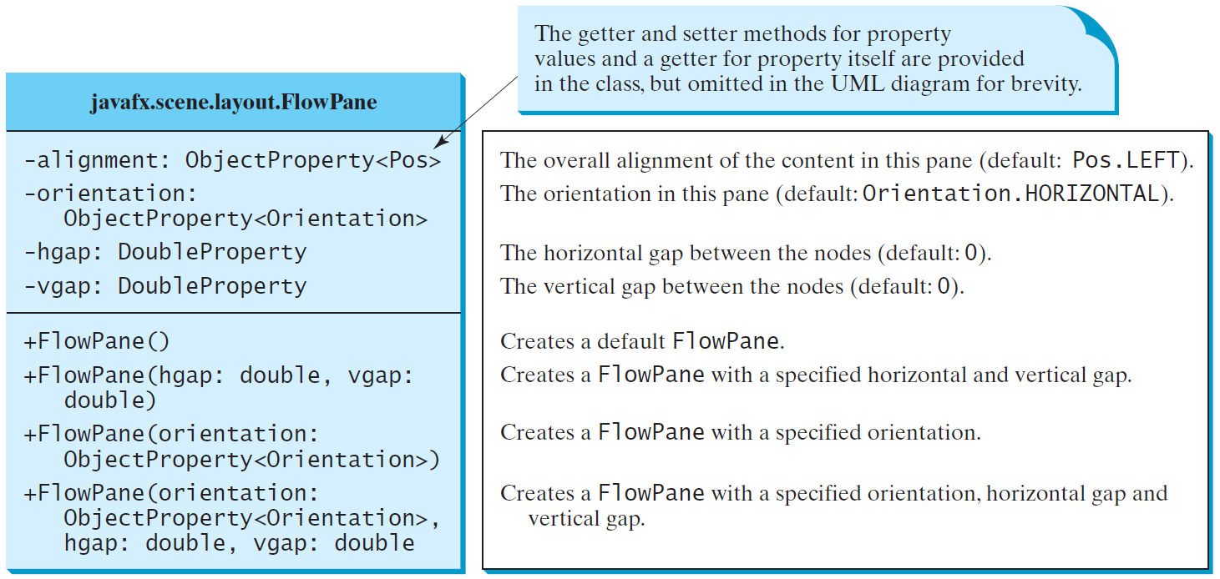
FlowPane
ShowFlowPane

Slide 24
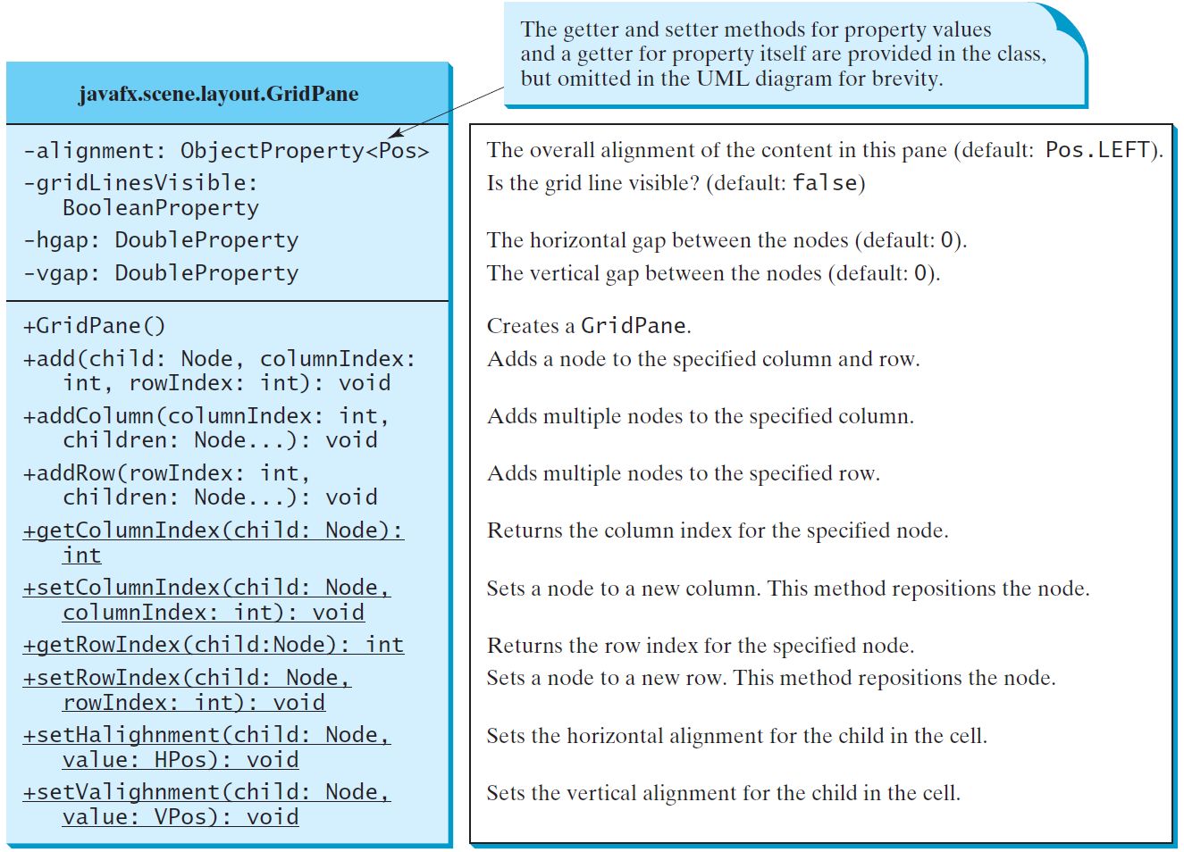
GridPane
ShowGridPane

Slide 25
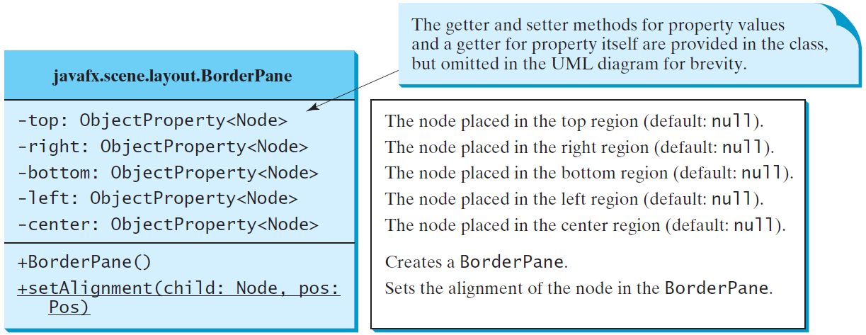
BorderPane

Slide 26
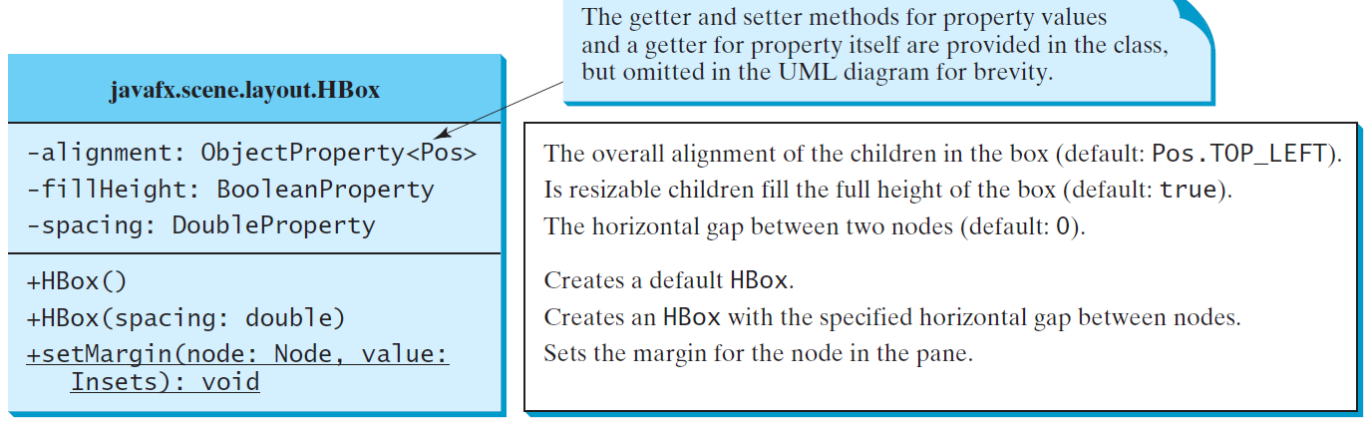
HBox

Slide 27
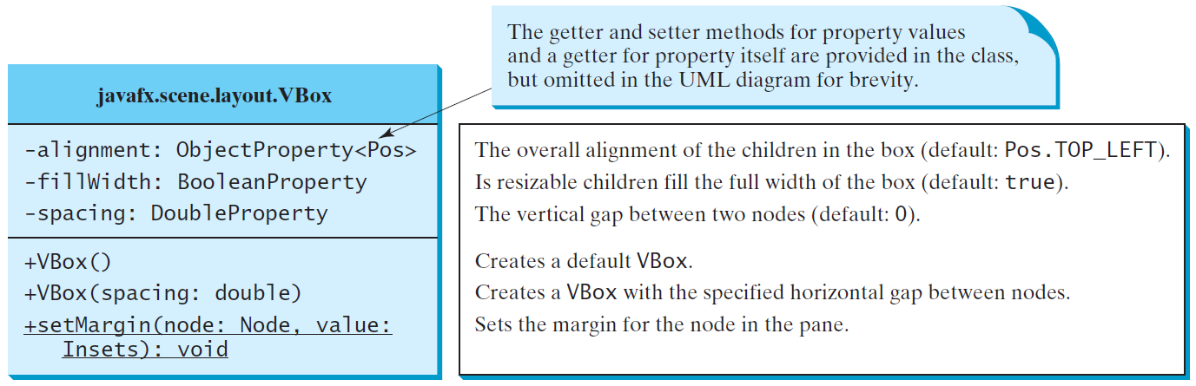
VBox
ShowHBoxVBox

Slide 28
Panes
Panes are unique in that they are both containers of other nodes and nodes themselves.
Complex GUI’s are constructed by using multiple panes. You can put a pane in another pane.
The last example using a BorderPane for the overall Stage and then puts other panes in the different areas of a BorderPane.

Slide 29
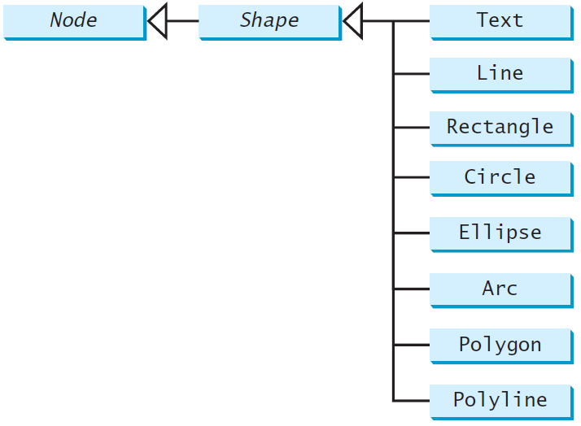
Shapes
JavaFX provides many shape classes for drawing texts, lines, circles, rectangles, ellipses, arcs, polygons, and polylines.

Slide 30
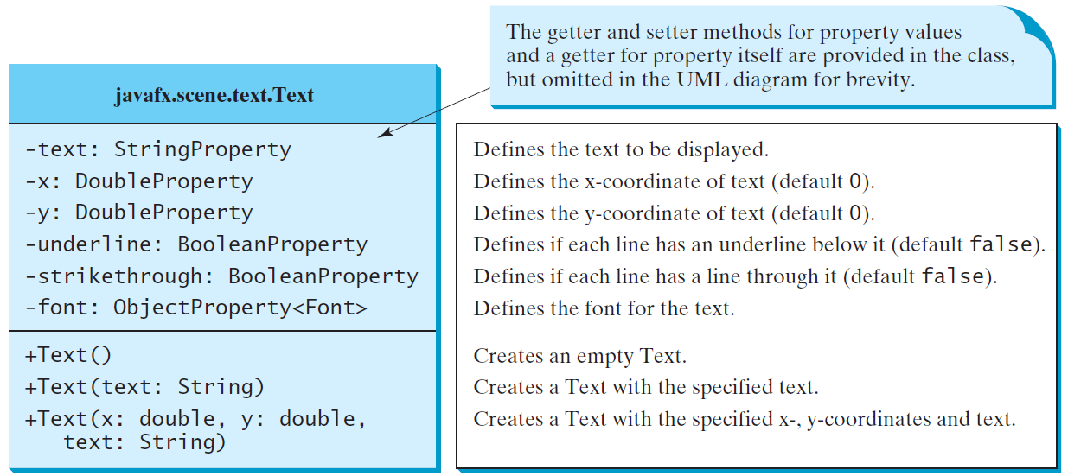
Text

Slide 31
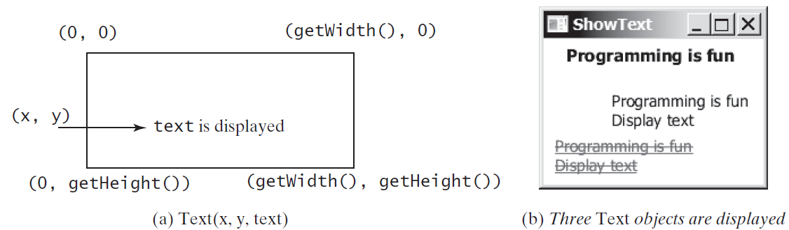
Text Example

Slide 32
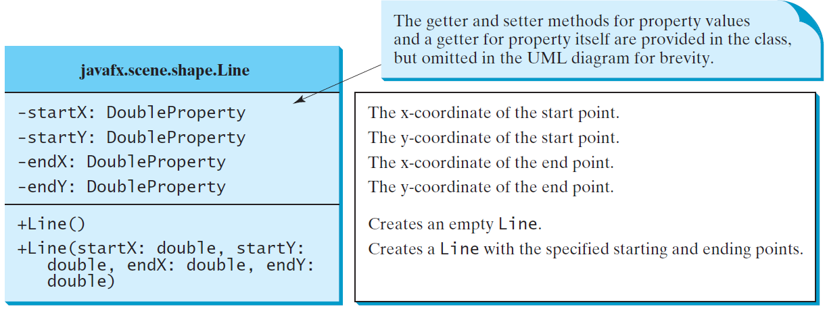
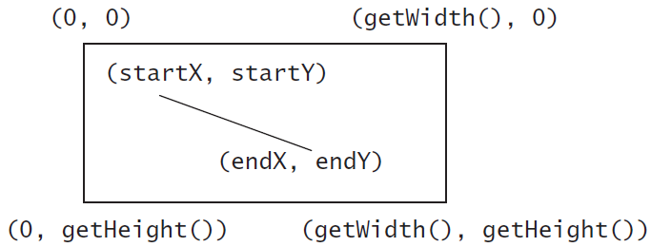
Line

Slide 33
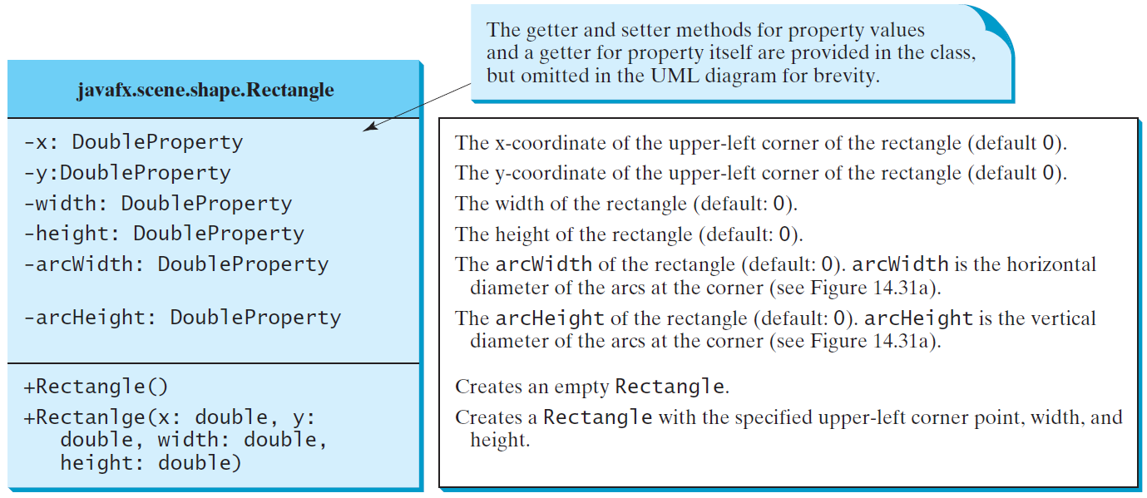
Rectangle

Slide 34
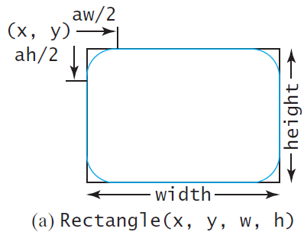
Rectangle Example

Slide 35
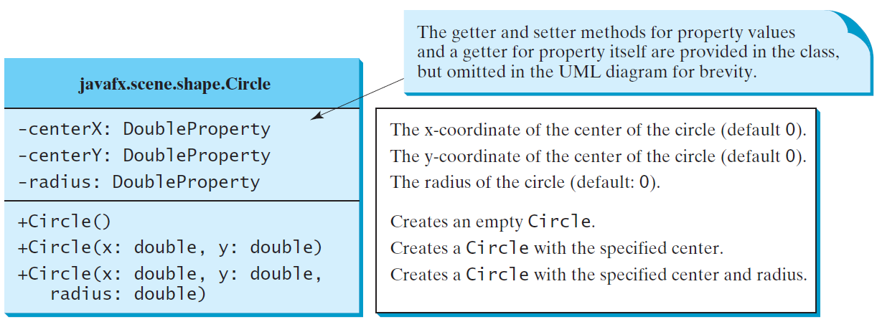
Circle

Slide 36
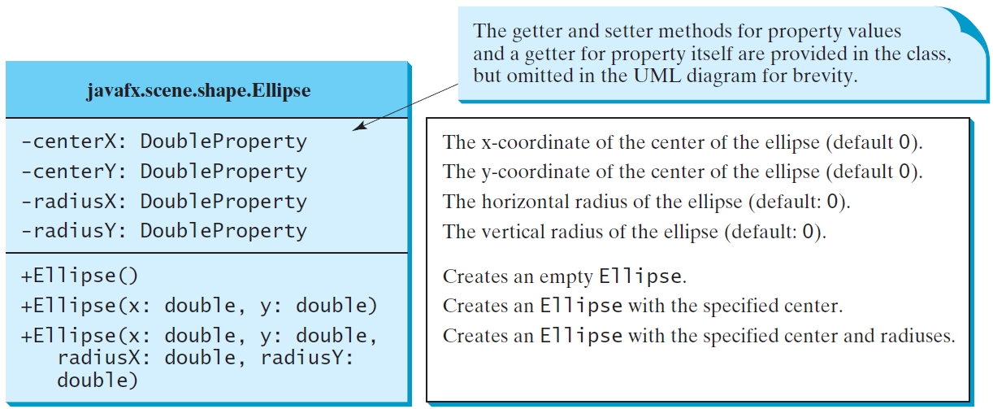
Ellipse

Slide 37
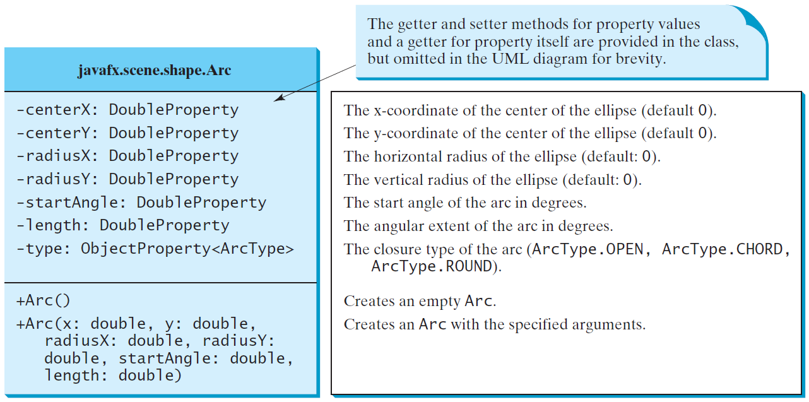
Arc

Slide 38
Arc Examples

Slide 39
Polygon and Polyline

Slide 40
Polygon

Slide 41
Case Study: The ClockPane Class
This case study develops a class that displays a clock on a pane.
ClockPane

Slide 42
Use the ClockPane Class
DisplayClock

Slide 43
Class exercise
Create a GUI that would allow us to enter information about the Person class
Need label stating “First Name” with TextField allowing user to enter it.
Ditto for last name and city and id
Buttons at bottom to Save or Cancel
Won’t actually work yet, just the look and feel

